Slide 1
Requirement Engineering
1

Slide 2
Requirement Engineering
λIEEE
“A condition or capability that must be met or possessed by a system or system component to satisfy a contract, standard, specification, or other formally imposed document”
Software Requirements are the wants and needs of the stakeholders.
System requirements specify what, not how.
It may range from a high-level abstract statement of a service or of a system constraint to a detailed mathematical functional specification
2

Slide 3
Requirement Engineering
λRequirement engineering is a sub discipline of software engineering that is concerned with determining the goals, functions, and constraints of software systems.
3

Slide 4
Levels of Requirements
λBusiness Requirements
ϒ High level objectives of the organization or customer requesting system or product
λUser Requirements
ϒ Describe tasks the user must be able to accomplish with the product or system
λFunctional Requirements
ϒ The software functionality the developers must build into the product to enable users to accomplish their tasks, thereby satisfying the business requirements
λNon-functional Requirements
ϒ These are constraints on the services or functions offered by the system. They include timing constraints, constraints on the development process, implementation constraints, security, standards etc

Slide 5
Levels Requirements
Problem Space
Problem
Problem-solving techniques
Needs
Solution Space
Understanding the needs Understanding application domain Understanding the solution
Features
Requirements
Analysis and Design
Implementation
Test

Slide 6
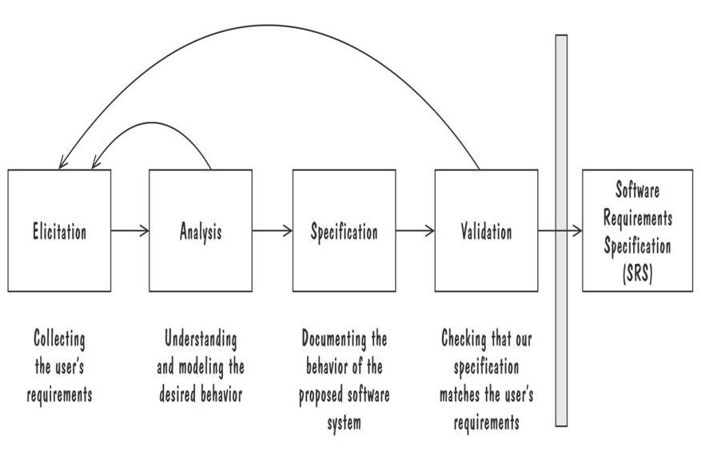
Requirements Engineering Process
λPerformed by the requirement analyst or system analyst
λThe final outcome is a Software Requirements
Specification (SRS) document
6

Slide 7
Understanding Requirements
A picture story

Slide 8
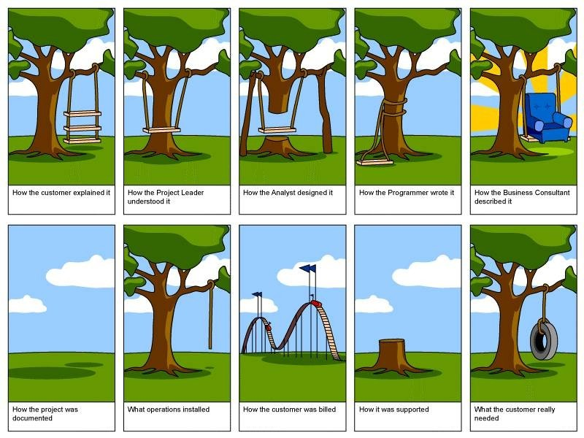

Slide 17
Barriers to Elicitation
Meaning:-
the process of getting or producing something, especially information or a reaction.
The “Yes, But” Syndrome
λThe “undiscovered Ruins (remains)” Syndrome
λThe “User and the Developer” Syndrome

Slide 18
The “YES, BUT” Syndrome
λWow this is so good BUT hmmm now that I see it what about this….?
ϒSoftware as an intangible intellectual property
ϒCode as the evaluation artifact
ϒWe are expected to get software right the first time.
λSolution
ϒTo identify the YES BUT syndrome early and try to eliminate it so that when you develop software you have already taken care of YES BUT syndrome

Slide 19
The “UNDISCOVERED RUINS” Syndrome
λQuestion by a Tourist“ so , umm how many undiscovered ruins are there?”
ϒThe more you found out, the more you know remains.
ϒYou are never really done with requirement elicitation and you never will be
Solution
λIdentification of all stakeholders during problem analysis
λShould know when to say “ We have discovered enough”
λMany techniques used for exploring requirements

Slide 20
The “USER AND THE DEVELOPER”
Syndrome
λCommunication gap
ϒDifferent words, different languages, different motivations etc.
λSolution
ϒUse techniques such as role playing, story boarding, throwaway prototypes to deal with articulation and communication problems.

Slide 21
Problem
Solution
Users do not know what they want, or they know what they want but cannot articulate it.
Recognize and appreciate the user as domain expert; try alternative communication and elicitation techniques.
Users think they know what they want until developers give them what they said they wanted.
Provide alternative elicitation techniques earlier: storyboarding, role playing, throwaway prototypes, and so on.
Analysts think they understand user problems better than users do.
Put the analyst in the user's place. Try role playing for an hour or a day.
Everybody believes everybody else is politically motivated.
Yes, its part of human nature, so let's get on with the program

Slide 22
Understanding Requirements
The challenge of Requirements Elicitation
λInterviewing stakeholders
λRequirements Workshop
λBrainstorming with current and potential users
λStoryboarding
λUse Cases
λPrototyping
22

Slide 23
Technique: Interviewing
Simple direct technique
Context-free questions can help achieve bias- free interviews
Then, it may be appropriate to search for undiscovered requirements by exploring solutions.
Convergence on some common needs will initiate a “requirements repository” for use during the project.
A questionnaire is not substitute for an interview.

Slide 24
Technique: Requirements Workshop
The requirements workshop is perhaps the most powerful technique for eliciting requirements.
It gathers all key stakeholders together for a short but intensely focused period.
Brainstorming is the most important part of the workshop.

Slide 25
Technique: Brainstorming
Brainstorming involves both idea
generation and idea reduction.
The most creative, innovative ideas often result from combining, seemingly unrelated ideas.
Various voting techniques may be used to prioritize the ideas created.
Although live brainstorming is preferred, web-based brainstorming may be a viable alternative in some situations

Slide 26
Technique: Storyboarding
The purpose of storyboarding is to elicit early “Yes, But” reactions.
Storyboards identify the players, explain what happens to them, and describes how it happens.
Make the storyboard sketchy, easy to modify.
Storyboard early and often on every project with new or innovative content.

Slide 27
Technique: Use Cases
λUse Cases, like storyboards, identify the
who, what, and how of system behavior.
λUse Cases describe the interactions between a user and a system, focusing on what they system “does” for the user.
λThe Use Case model describes the totality of the systems functional behavior.
λEarly stages: After you have an overview of the use cases, expand 10% of them in detail.

Slide 28
Technique: Prototyping
Prototyping is especially effective in addressing the “Yes, But” and the “Undiscovered Ruins” syndromes.
A software requirements prototype is built to help developers, users, and customers better understand system requirements.
Prototype the “fuzzy” requirements: those that, although known, are poorly defined and poorly understood.

Slide 29
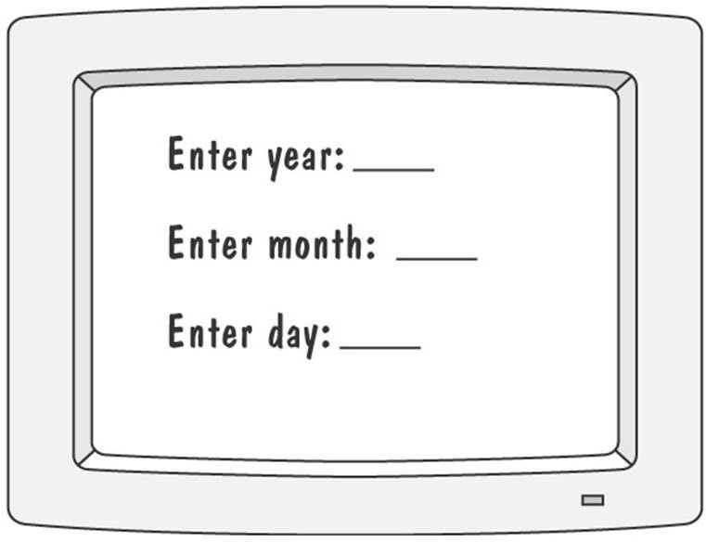
Prototyping Example
Prototype for building a tool to track how much a user
exercises each day
The users will need to enter the date for exercise routine so user interface is important as users might
not be familiar with computer use.
1) Graphical representation of first prototype, in which the user must type the day, month and year

Slide 30
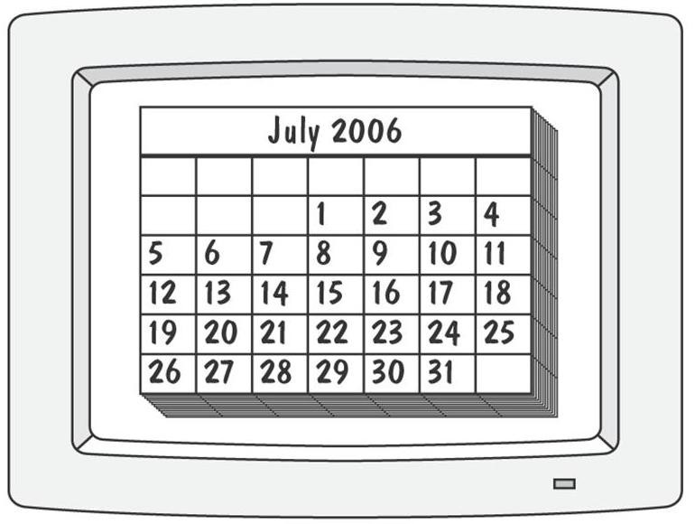
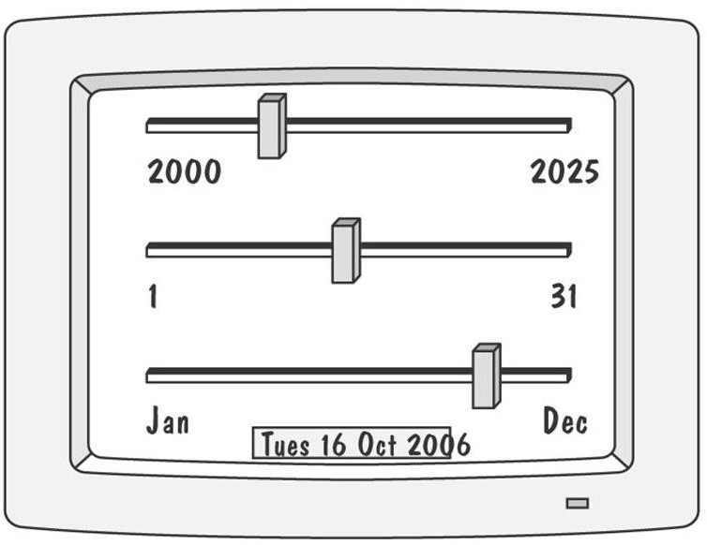
Prototyping Example
The system displays the chart for that
month, and the user selects the appropriate date in the chart
Third prototype shows that instead of a calendar, the user is presented with three slide bars

